Slide 1




NEXT GEN EMPLOYABILITY PROGRAM
Creating a future-ready workforce
Team Members
College Name
Student Name :F.Saran Kelha
Student ID : 960221104103
Arunachala College of Engineering for Women

Slide 2

CAPSTONE PROJECT SHOWCASE
Project Title
Car Rentals Application with Django Framework
Abstract | Problem Statement | Project Overview | Proposed Solution | Technology Used | Modelling & Results | Conclusion

Slide 3
Abstract
Our car rental website prioritizes user experience, offering a seamless interface for browsing and booking a variety of vehicles. Key features include secure online booking, transparent pricing, and detailed rental information. For service providers, a management dashboard and analytics tools optimize operations. By prioritizing convenience and transparency, our platform aims to redefine the car rental experience for both users and providers.
Source :

Slide 4
Problem Statement
The current car rental landscape suffers from two critical deficiencies: the absence of an online booking platform and the lack of easy payment options. Without an online presence, customers face inconvenience and limited information access, while service providers struggle with manual processes. Simplifying booking and payment processes is essential to enhancing user experience and operational efficiency in the car rental industry.
Source :

Slide 5
Project Overview
The project aims to develop a user-friendly online platform for car rentals, addressing the existing challenges of manual booking processes and limited payment options. The platform will streamline the rental experience for both customers and service providers, offering a comprehensive solution to revolutionize the car rental industry.
Key features of the project include:
1. Online Booking System: Implementing a secure and intuitive online booking system that allows customers to browse available vehicles, select rental dates, and complete bookings with ease.
2. Transparent Pricing: Providing transparent pricing information, including rental rates, additional fees, and optional add-ons such as insurance coverage and GPS navigation systems.
3. Secure Payment Gateway: Integrating a secure payment gateway to facilitate seamless online transactions, offering customers a variety of payment options for added convenience and security.
4. User-Friendly Interface: Designing a user-friendly interface that ensures a smooth and intuitive browsing and booking experience for customers, enhancing overall satisfaction and engagement.
Source :

Slide 6
Proposed Solution
Our proposed solution involves the development of an intuitive online platform that transforms the car rental experience by offering a user-centric interface for seamless navigation and booking, comprehensive vehicle listings with detailed profiles, a secure online booking system, transparent pricing, flexible payment options, real-time availability updates, and robust management tools for service providers. By addressing the existing gaps in the industry with these features, our solution aims to enhance convenience, transparency, and efficiency for both customers and service providers, ultimately revolutionizing the way car rentals are conducted.
Source :

Slide 7
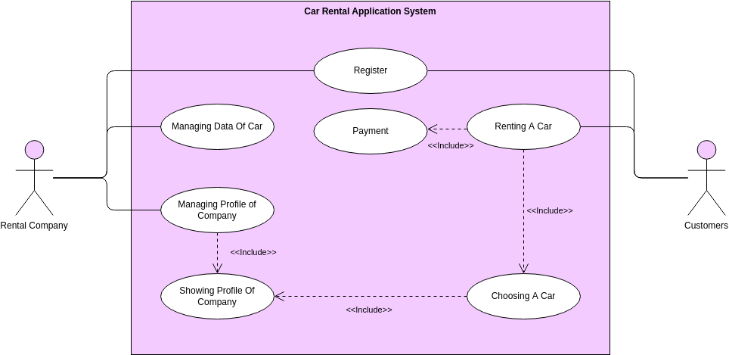
Project Architecture
Source :

Slide 8


Technology Used
Front-end
Back-end
Source :

Slide 9
Modelling & Results
We utilized user experience design principles and agile development methodologies to create an intuitive car rental platform. Our backend architecture supports real-time updates, secure payments, and inventory management. Through iterative refinement and user testing, we've ensured optimal usability. Early feedback indicates high satisfaction and increased booking rates, affirming the effectiveness of our solution in enhancing convenience and efficiency for users and service providers alike.
Source :

Slide 10
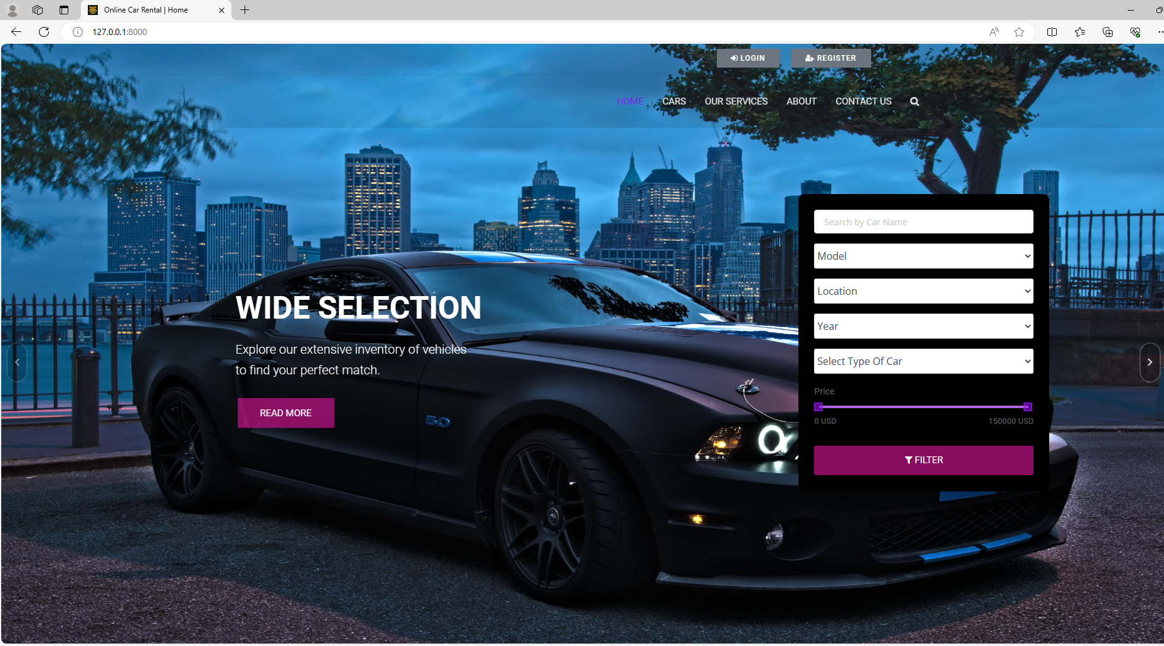
Homepage

Slide 11
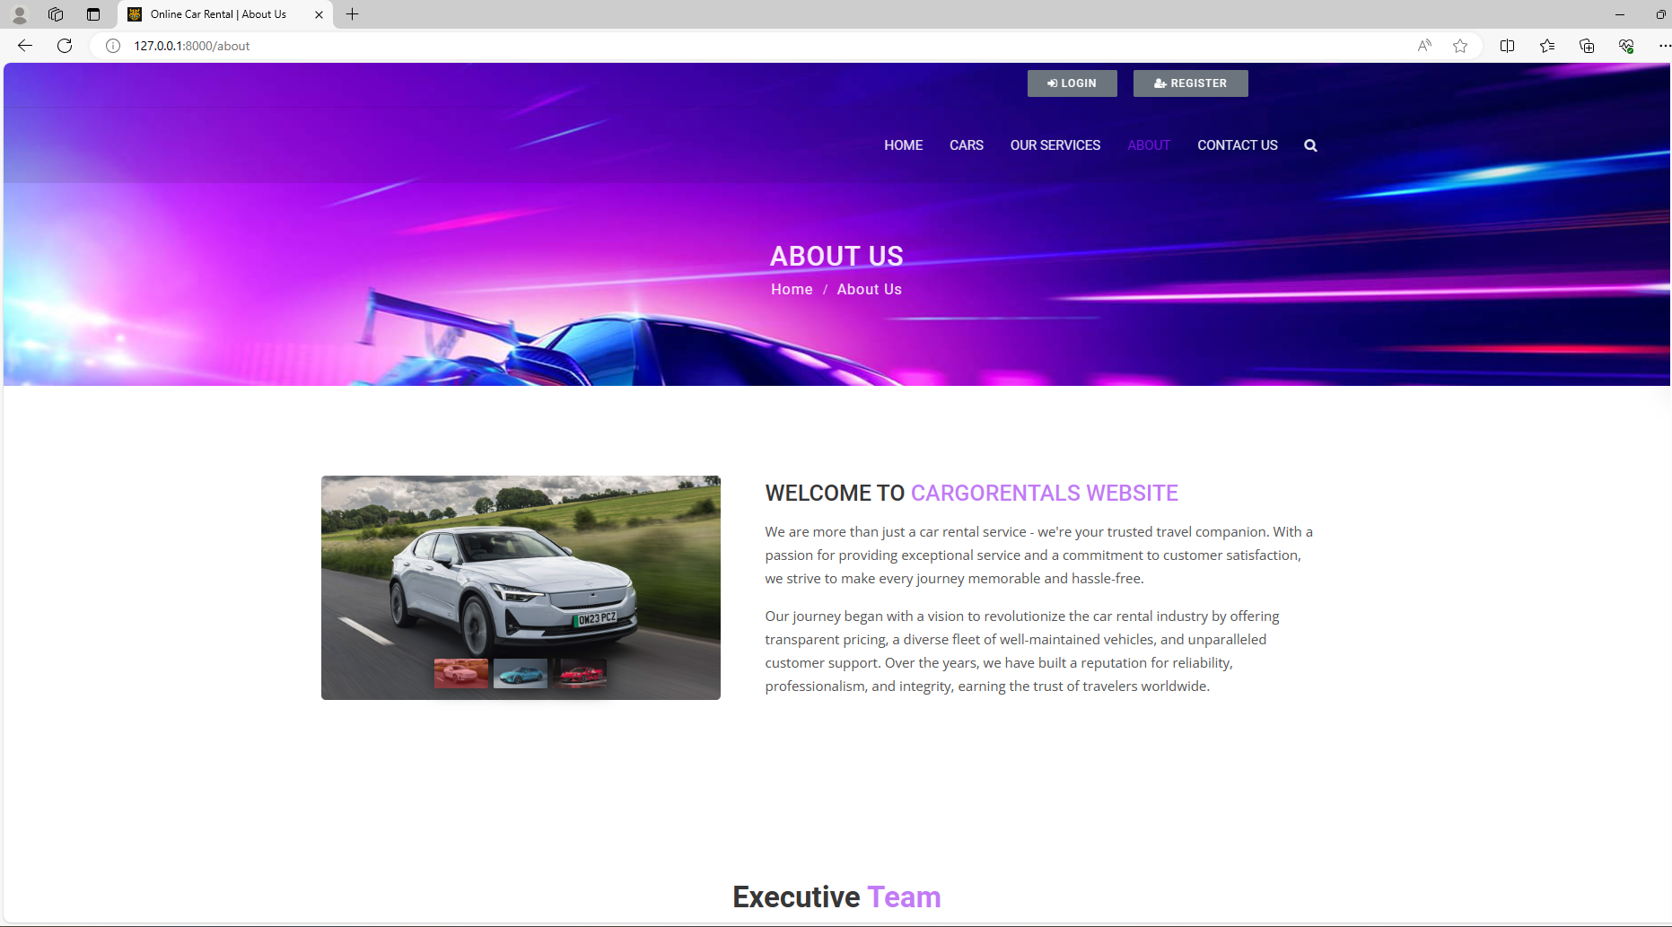
About-Us-Page

Slide 12
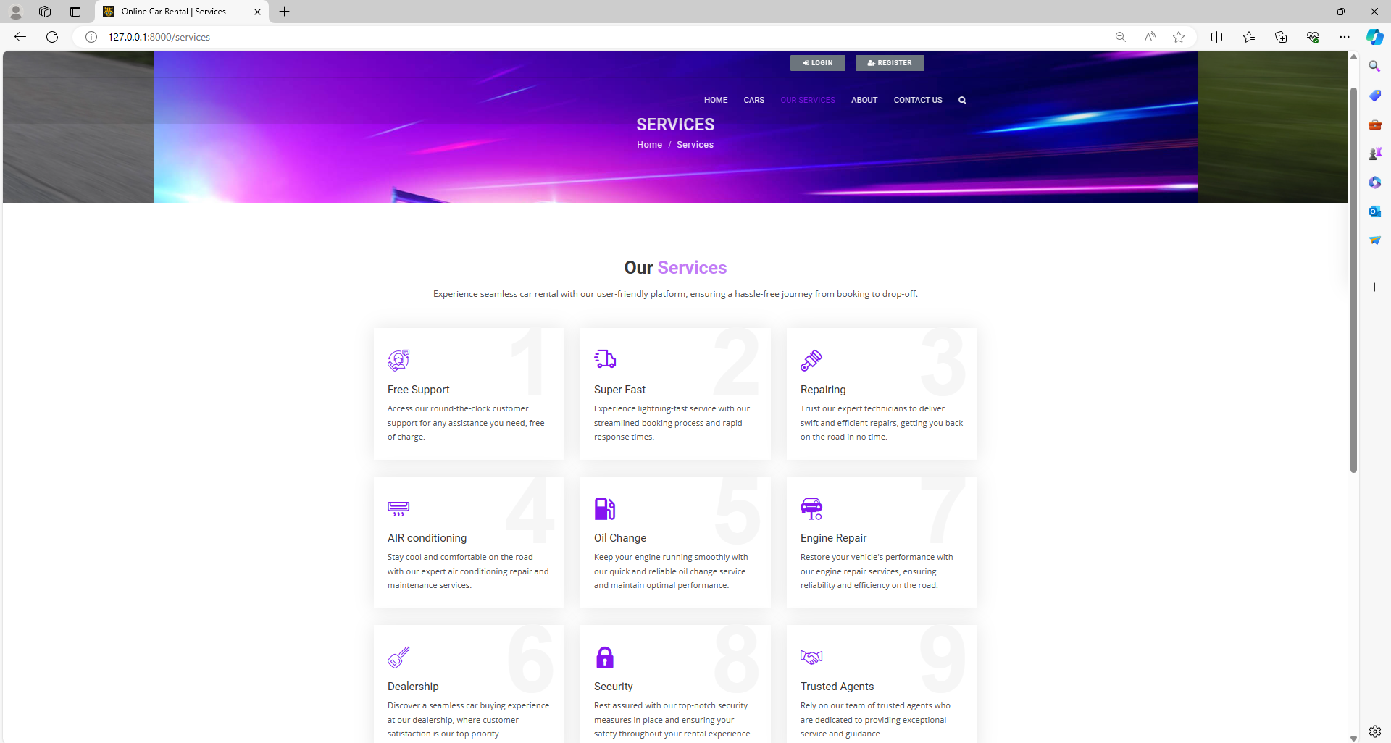
Service-Page

Slide 13
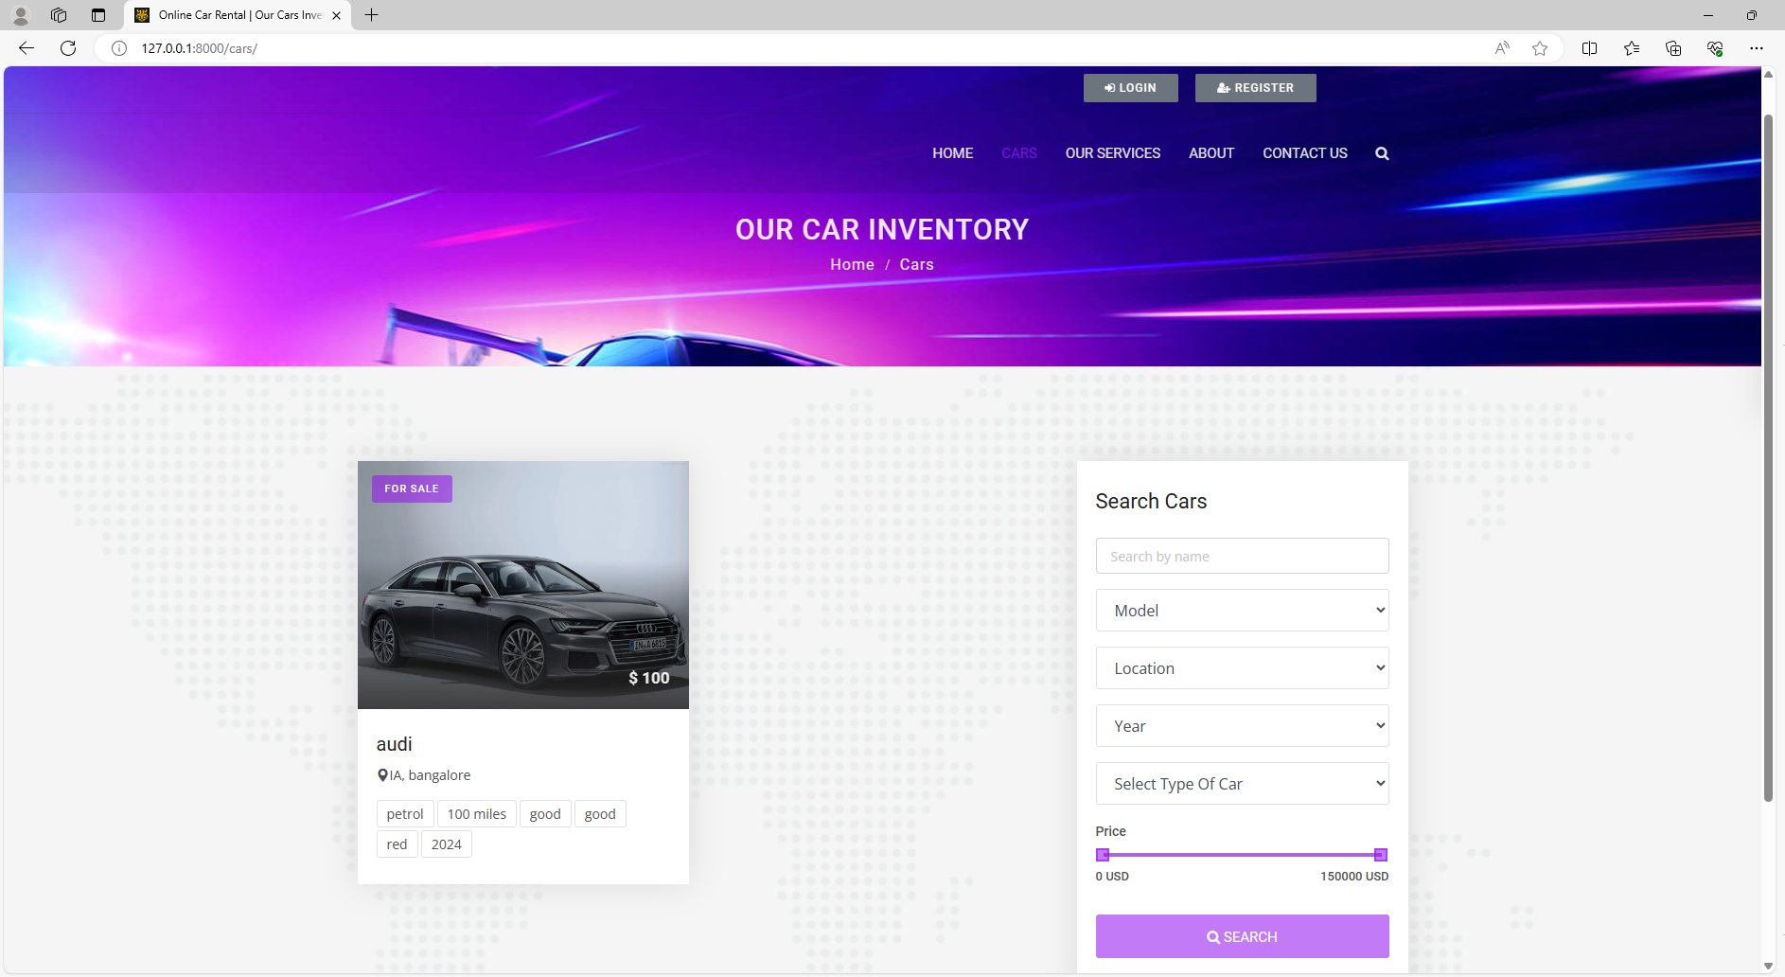
Cars-Page

Slide 14
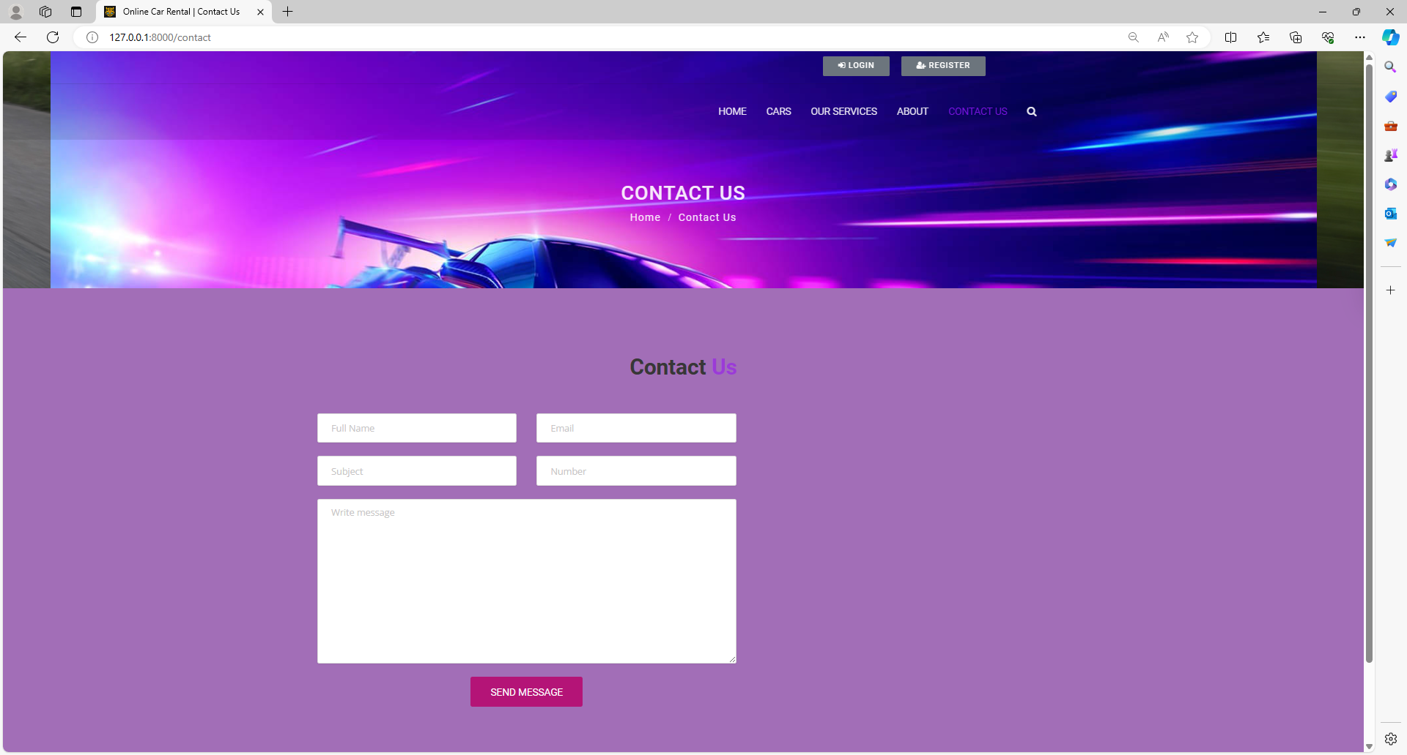
Contact Us-Page

Slide 15
Future Enhancements:
Looking ahead, we envision several enhancements to further elevate the car rental platform's capabilities and user experience. These include:
1. Integration of Artificial Intelligence: Implementing AI-powered features such as personalized recommendations based on user preferences and past bookings, dynamic pricing algorithms to optimize rental rates, and chatbots for instant customer support.
2. Expansion of Vehicle Options: Diversifying the vehicle fleet to include electric and hybrid cars, as well as specialty vehicles like camper vans or luxury models, to cater to a wider range of customer preferences and needs.
3. Enhanced Mobile Experience: Investing in mobile app development to offer a seamless booking experience on smartphones and tablets, with features such as push notifications for booking updates and geolocation services for easier vehicle pickup and drop-off.
4. Eco-Friendly Initiatives: Introducing sustainability initiatives such as carbon offset programs or partnerships with eco-conscious vehicle manufacturers to promote environmentally friendly transportation options and reduce the platform's carbon footprint.

Slide 16
Conclusion
In short, our user-centric car rental platform has successfully addressed industry challenges through intuitive design and robust technology. By prioritizing convenience and efficiency, we've created a seamless experience for customers and service providers alike. Moving forward, we're committed to further innovation, including AI integration, expanded vehicle options, and sustainability initiatives, to maintain our position as a leader in the industry.
Source :

Slide 17
Thank You!
Notes:
Thank You !!

